Slide 1
TECH460 Module 4
Technology Selection and Design

Slide 2
Rubric
Criteria | Total
Include problem statement from previous deliverable | 10
Identification of two alternative technologies | 20
Qualitative analysis of technologies | 20
Quantitative analysis of technologies | 20
Technology selection and justification | 40
High-level design | 40
Total | 150

Slide 3
Problem Statement
Support Ray-Ban and Meta’s addition of an augmented reality visual layer on their flagship devices under the Smart Glasses line through the design of a mobile interface to augment the current selling points of the device
Display visual information related to AI search
Provide visual feedback to partner with audio feedback for major features like calling, AI search, capture, etc.
Allow user to disable through the use of an audio command or touchpad

Slide 4
Alternative Technology Approaches
Micro Projection onto the lenses
MicroOLED display
MicroLED display
As these are the primary hardware technologies available here, the software would need to be designed to interface between the display and the current functions of the device
Framework can be built in C++, JavaScript, and C# to match current Oculus development
Application will be completely integrated with the device and effectively non-accessible otherwise to users
Application would need to be fine-tuned to suit the display to be used, eg
Single color and high resolution
Multicolor and steps would need to be taken to save battery
(currently not available) multicolor with good depth availability

Slide 5
Qualitative Analysis
Micro Projection
Advantages
Battery life
Faster fine-tuning time
Higher resolution
Disadvantantages
Single color
Limited definition due to single color
MicroOLED
Advantages
Multicolor
Disadvantantages
Super hot, battery life is not so good
Very visible on tented lenses only
Smaller display available
MicroLED
Advantages
Cooler technology
Visible in clear lenses with high definition
Disadvantantages
Technology is not available at this time

Slide 6
Quantitative Analysis
Initial development cost 28k to 43k - this will occur no matter what display tech is chosen
Micro Projector fine-tuning: ~10k per frame + 5k per lens color
MicroOLED fine-tuning: ~10k per frame + 10k-15k per lens color
Estimated based on Crowdbotics with inputs:
Other Platform
Partial wireframes
Figma
Intermediate Design & Workflows
Fashion industry
Productivity software

Slide 7
Recommended Solution
Micro Projection
Justification
Faster development time
Technology is actually available and easily developed in
Battery life will not be impacted as much as the other options
Multiple projectors can be used to obtain the desired resolution where needed

Slide 8
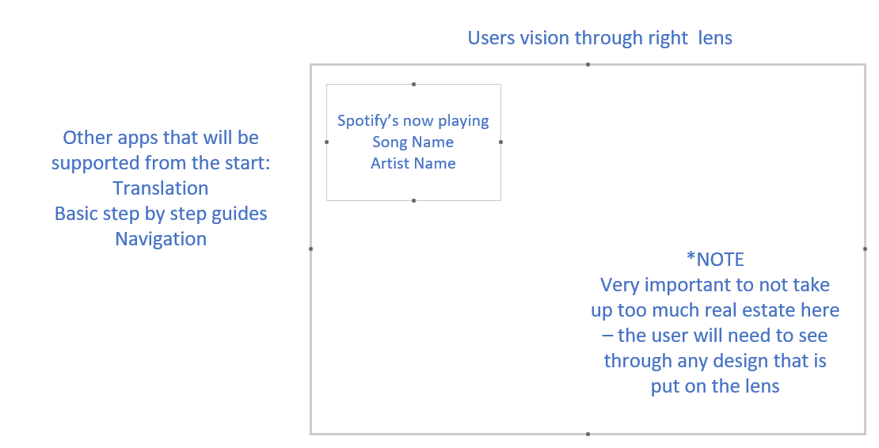
High-Level Design: Basic wireframe placement

